Slide 1
Predicting Student Dropout and Academic Success
Design, implementation, evaluation, and responsible use of a multiclass ML decision-support system
Problem
→
Data
→
Preprocess
→
Model
→
Evaluate
→
Explain
→
Govern
Technical presentation based on the final narrative report • Post Graduate Diploma in Artificial Intelligence and Machine Learning
ARISTOTLE D MAGLASANG

Slide 2
Project at a Glance
2
From institutional problem to operational decision support
DATASET
RAW VARIABLES
TARGET
FINAL FEATURES
BEST MODEL
4,424
37
3 classes
50
Random Forest
student records
36 predictors + target
Dropout • Enrolled • Graduate
importance-selected
0.77 acc • 0.70 macro F1
Decision objective
ML formulation
Key technical tension
Identify students who may require timely academic, financial, mentoring, or counseling support—without turning predictions into automated decisions.
Supervised multiclass classification with class-aware evaluation because the outcome distribution is moderately imbalanced.
The Enrolled class is materially harder to distinguish, so accuracy alone is insufficient; macro F1 and class-level errors matter.

Slide 3
Why This Problem Matters
3
Prediction is valuable only if it changes the timing and quality of intervention
Late detection
Operational value proposition
Risk becomes visible only after performance deteriorates.
• Move from reactive remediation to proactive student support.
• Prioritize advising, tutoring, mentoring, counseling, and financial assistance.
• Use interpretable risk signals rather than opaque scores.
• Treat retention and graduation as downstream KPIs requiring longitudinal validation.
Reactive support
Advising and assistance arrive after disengagement has begun.
Resource dilution
Limited support capacity is not prioritized by evidence.
Important boundary
Predictive triage
The model predicts associations, not causality. A high-risk prediction is a trigger for assessment and support—not a label or deterministic outcome.
Risk scores + explanations can focus human review earlier.

Slide 4
Dataset and Prediction Target
4
A multidimensional student profile with moderate class imbalance
Target distribution
Academic
Graduate
2,209
semester grades, approved/enrolled/evaluated curricular units
Financial
Dropout
1,421
tuition up-to-date, debtor, scholarship
Enrolled
794
Admission
admission grade, previous qualification
Class imbalance is not extreme, but it is sufficient to make class-specific Precision/Recall/F1 and macro F1 necessary.
Demographic
age, gender, marital status, international
Context
unemployment, inflation, GDP

Slide 5
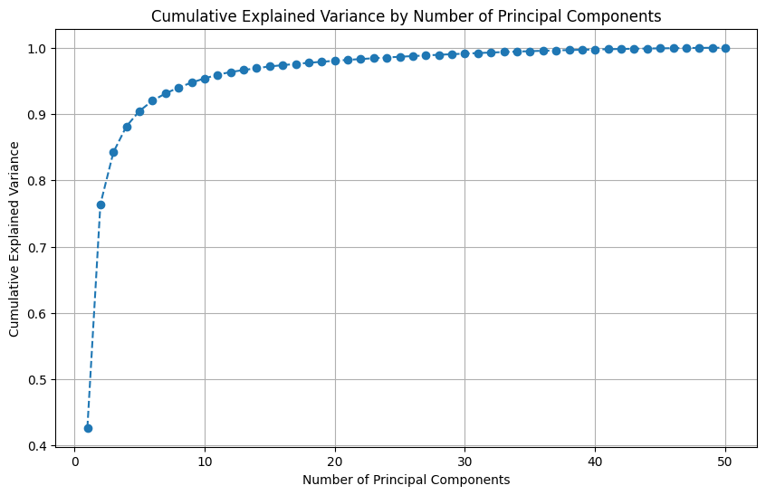
End-to-End ML Design
5
The final classifier uses selected original/encoded features—not PCA components
1
→
2
→
3
→
4
→
5
→
6
→
7
Quality check
Outlier handling
Representation
Feature selection
Split
Modeling
Evaluation + XAI
No missing values No duplicates
1st–99th percentile capping
One-hot encoding + standardization
Random Forest importance Top 50 features
80:20 stratified random_state=42
LR • DT • RF • XGB
Macro F1 • confusion SHAP • LIME • PDP/ICE
PCA
PCA was used to inspect the variance structure of the selected feature space. It was explicitly not used as the final model representation.

Slide 6
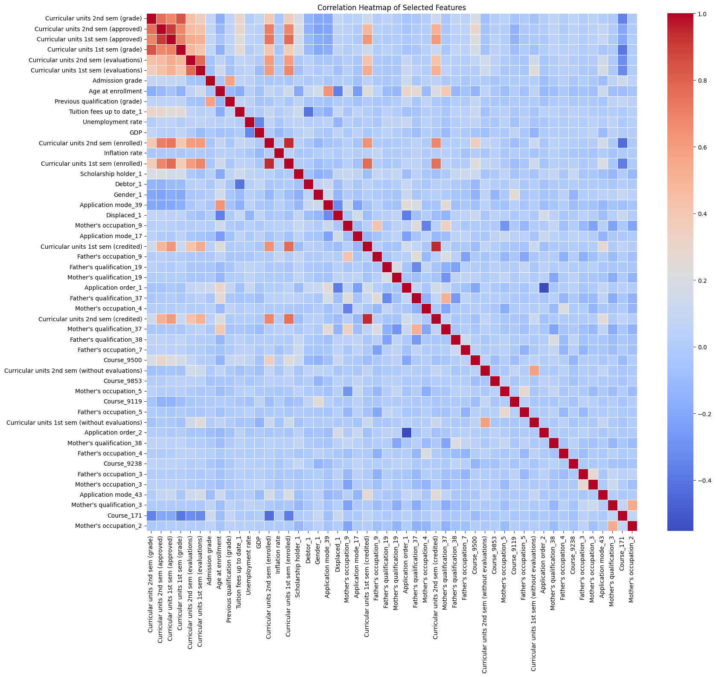
Preprocessing and Feature Engineering
6
Design choices, rationale, and technical implications
No imputation
Complete dataset; avoid introducing imputation assumptions.
Percentile capping
Preserve all observations while limiting extreme-value influence.
One-hot encoding
Convert coded categorical variables into indicators; drop first category.
Standardization
Normalize scale for algorithms sensitive to feature magnitude.
Importance selection
Reduce dimensionality after encoding to 50 predictors.
Correlation analysis informs redundancy; it does not establish causal relationships.

Slide 7
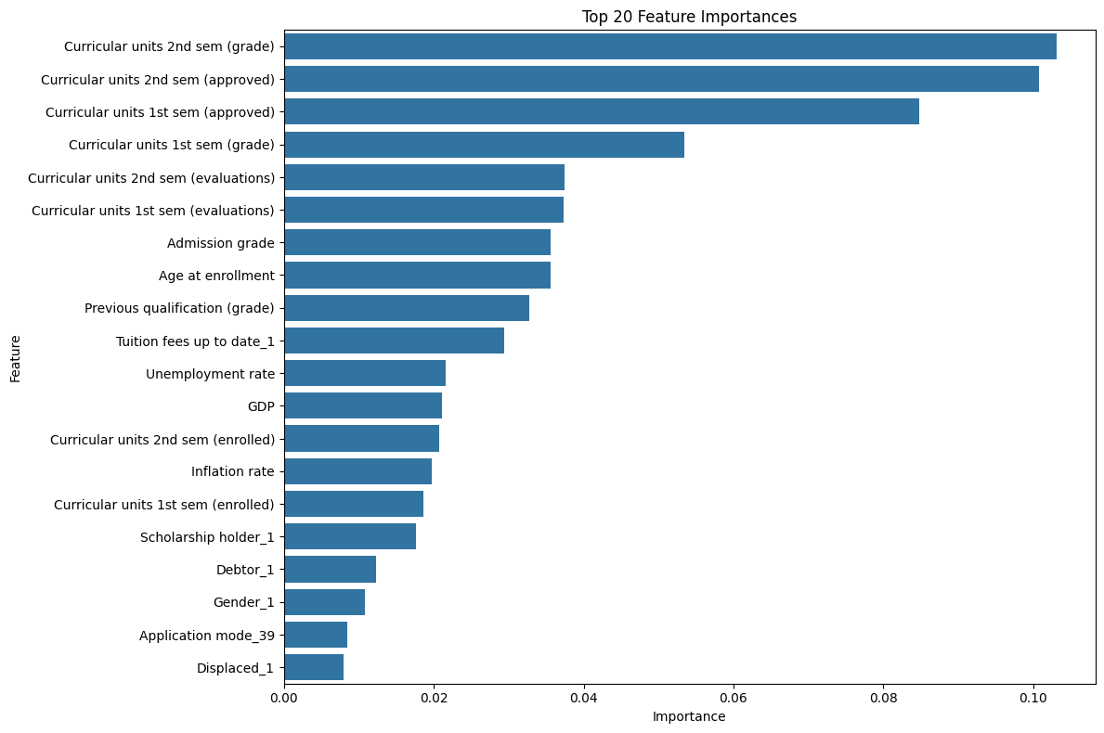
What the Model Learns
7
Academic progression dominates the predictive signal
Strongest signals
2nd-semester grade and approved units, followed by 1st-semester approved units and grade.
Secondary signals
Admission grade, age at enrollment, previous qualification grade, tuition status, scholarship status.
Interpretation
The predictive framework is largely reading academic progression, with financial and admission variables adding context.
Caution: importance ≠ causality; correlated features can share or redistribute importance.

Slide 8
Model Performance
8
Random Forest provides the best balance across classes
RF ACCURACY
RF MACRO F1
0.77
0.70
test set
best overall
Why macro F1?
It gives equal weight to all three outcomes despite unequal class frequencies.
Key result
A single Decision Tree underperforms. Ensemble methods and the linear baseline are materially stronger.

Slide 9
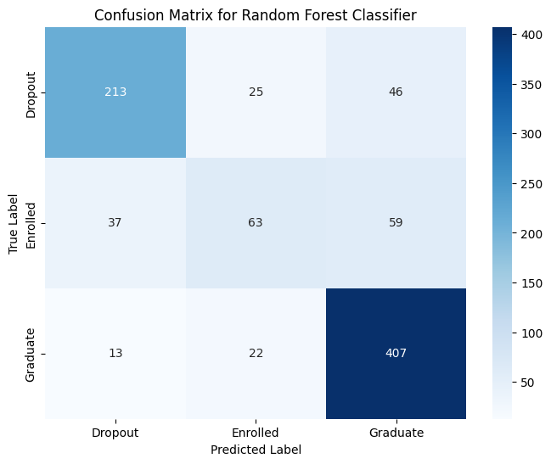
Class-Level Error Analysis
9
The Enrolled class is the bottleneck
Interpretation
Enrolled students plausibly overlap with both eventual graduates and dropouts. This is a label/state ambiguity problem as much as a modeling problem.

Slide 10
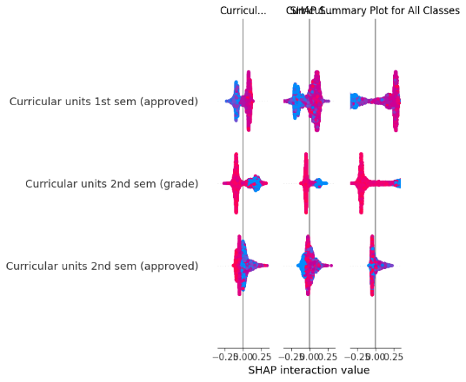
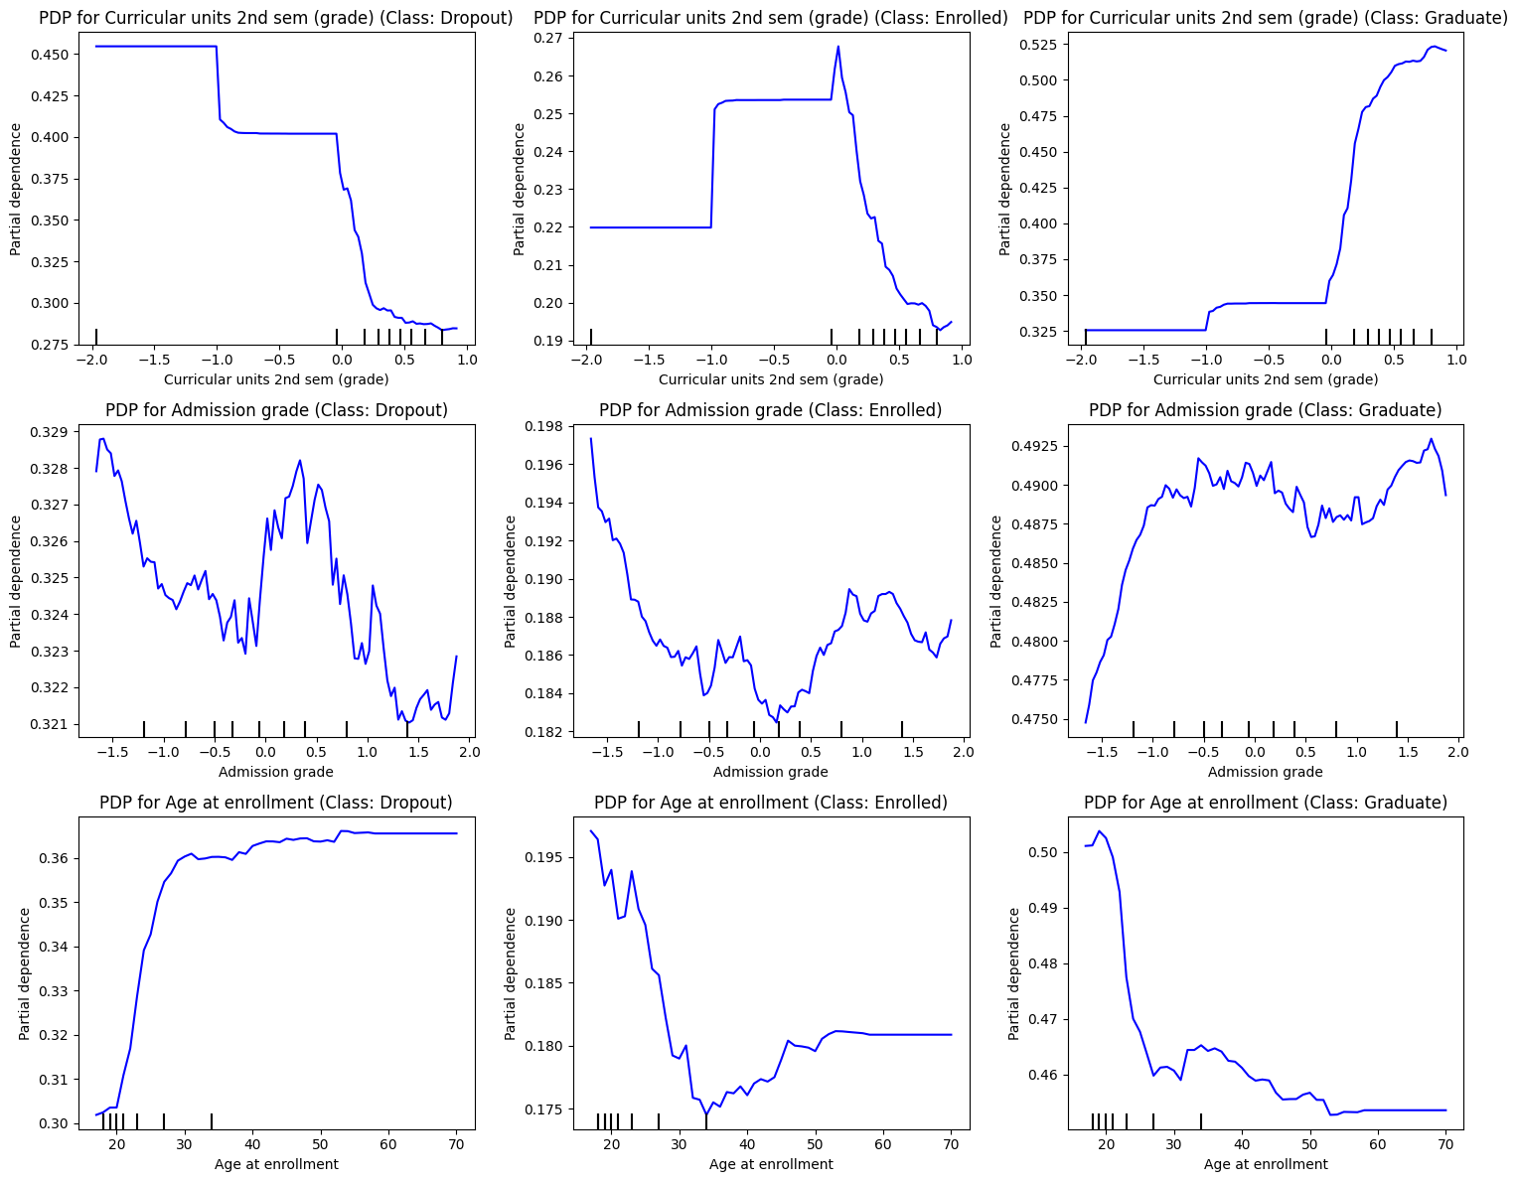
Explainable AI Stack
10
Global behavior + local explanations + response curves
Feature Importance
SHAP
LIME
PDP + ICE
Global ranking of predictors used by Random Forest.
Direction and magnitude of feature contributions across predictions.
Local surrogate explanation for a single student prediction.
Average and individual response patterns for important features.
Explanations are complementary; no single XAI method is sufficient for model governance.

Slide 11
Fairness, Ethics, and Model Risk
11
Educational prediction requires governance, not just validation metrics
Sensitive / proxy attributes
Human-in-the-loop
Gender, age, scholarship, debtor status, international status; financial variables may encode socioeconomic effects.
Predictions initiate review/support; they do not authorize punitive or automatic decisions.
Fairness concepts
Privacy
Demographic Parity • Equalized Odds • Disparate Impact.
Student demographic, financial, and academic data require controlled access across the data lifecycle.
Mitigation options
Non-causal interpretation
Class reweighting, threshold optimization, cautious oversampling/SMOTE, periodic retraining and audits.
The system estimates predictive relationships; it does not establish why a student drops out.

Slide 12
Key Takeaways
12
What is essential to communicate in a postgraduate AI/ML presentation
Problem framing
The value is early, targeted support—not classification for its own sake.
1
Pipeline integrity
Preprocessing → selection → stratified split → model comparison → XAI must be described precisely.
2
Balanced evaluation
Random Forest: 0.77 accuracy, 0.70 macro F1; Enrolled F1=0.47 remains the main weakness.
3
Interpretability
Academic progression is the dominant signal; XAI makes global and local behavior reviewable.
4
Responsible deployment
Human oversight, fairness, privacy, drift monitoring, and longitudinal impact evaluation are part of the ML system.
5

